Slide 1
Welcome to the Activity
Get out a piece of paper and draw three lines in the middle of the page, like this:

Slide 2
Get out a quarter, nickel, and penny. If you do not have these coins, tear three pieces of paper into small, medium, and large pieces (roughly coin-sized).
Arrange your items on the lines like this:

Slide 3
Your task:
This is your initial state:
This is your goal state:
The obstacle is that you can only move one item at a time, and no item can be on top of a smaller item.
OK
Not OK

Slide 4
Your Task
Reach the goal state in as few moves as possible. Count the number of moves you make and record it on your paper. When you are finished, try to beat your score.

Slide 5
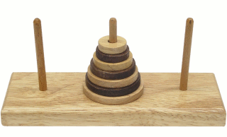
Explanation
This is a version of a task called the Tower of Hanoi. It is a test of problem-solving ability. The minimum number of moves to reach the goal state from the initial state (with three items) is seven moves. Reaching the goal in the minimum number of moves requires the use of working memory, visual imagery, and planning skills. This test is also used by neuropsychologists to evaluate problem-solving deficits in patients with brain damage.

Slide 6
With practice, you can improve. More difficult versions of this task exist that use more than three items. Try it now using four items. (Use your dime or a tiny scrap of paper as the fourth item.) The minimum number of moves to reach this goal state is fifteen.
Initial state:
Goal state:

Slide 7
Play online
http://www.dynamicdrive.com/dynamicindex12/towerhanoi.htm

